Slide 1
Human emotion detection from speech
CS613 Machine Learning
By: Natasha Lalwani,
Nishchala Barde

Slide 2
Introduction:
We consider the problem of identifying human emotions from speech samples.
Our aim is to experiment with various methods of classifying emotions and better understand the most distinctive features of emotions.
The motivation and idea for this topic came from the fact that applications like speech assistants are widely used today and there is ongoing work on speech assistants that can actually have human-like conversations and understand human emotions.
The other reason is that we wanted to work on a different type of data. The objective here is to learn how we can process audio data to feed it to the classification model.

Slide 3
Dataset for Project
The dataset we choose to use is the Kaggle dataset –
https://www.kaggle.com/uwrfkaggler/ravdess-emotional-speech-audio
This dataset is labeled dataset and contains audio files (16bit, 48kHz .wav) from the RAVDESS.
Each of the 1440 files has a unique filename. The filename consists of a 7-part numerical identifier. These identifiers define the stimulus characteristics.
Filename example: 03-01-06-01-02-01-12.wav
1. Audio-only (03)
2. Speech (01)
3. Fearful (06)
4. Normal intensity (01)
5. Statement "dogs" (02)
6. 1st Repetition (01)
7. 12th Actor (12) Female, as the actor ID number is even.

Slide 4
Dataset for Project
For this project, we split our dataset into three parts:
1. Train data: Will be used to train our models and learn their parameters.
2. Validation data: Will be used to select the optimal parameters for the models. For example, for K-NN, we use this data to select optimal value of K and similarly in CNN, to decide when to stop training and to select the optimal checkpoint.
3. Test data: This data will not be used during training. It will be used to report final results (performance measures) after the training is finalized.

Slide 5
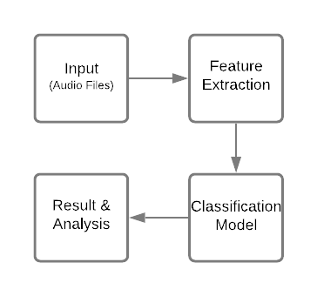
Approach
Since our raw data is in the audio file format, it will be a challenge to extract relevant features from the data.
To overcome that, we can convert the audio data into image form using librosa library in python. This library helps to visualize the sound data. Librosa is also used to extract features, such as MFCCs, chromagram, melspectrogram, spectral contrast, tonnetz, from an audio dataset
In order to classify the emotions, we implemented different machine learning models such as KNN, SVM, Logisitc Regression Classifier and Random Forest Classifier.
We also implemented the idea of ensemble learning in order to increase the accuracy.
Ensemble techniques are a type of machine learning methodology that integrates numerous base models to create a single best-fit predictive model.
We used a Voting Classifier which is a machine learning model that learns from an ensemble of many models and predicts an output (class) based on the highest probability of the output being the chosen class.
Block Diagram illustrating basic outline

Slide 6
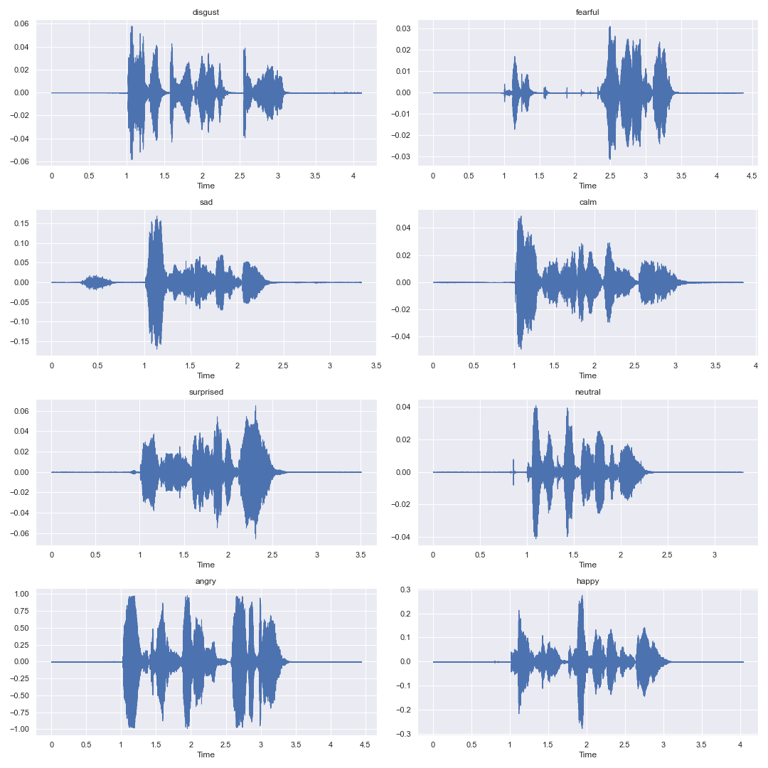
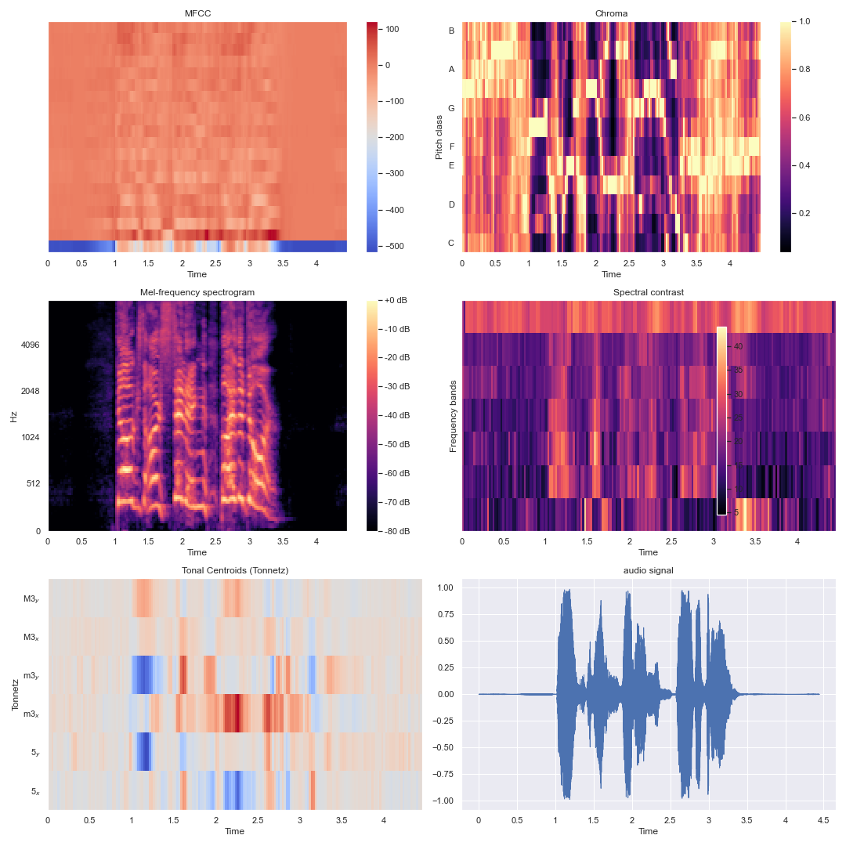
Waveform of each emotion (one audio file per emotion)
Extracted Features for a single audio file

Slide 7
Conclusion
The objective of this project was to compare different machine learning models in terms of classifying the human speech from given audio data set. We also explored the concept of ensemble learning to see if the accuracy improved as compared to the traditional models. On comparing individual models highest accuracy was obtained from SVM model; 59%. For our ensemble learning model, we combined the results of SVM, Logistic Regression model and KNN model, and got an accuracy of 60%. As seen, there wasn't much improvement in the accuracy. Better results can be obtained by conducting a more through hyper-parameter tuning, by implementing a more complex model, etc.

Slide 8
Future Scope
The impact of features on enhancing or lowering accuracy is significant. More features could be extracted before training the model. Deep learning is currently the most used machine learning algorithm. The next stage will be to use deep learning to construct a more accurate system of emotion recognition from speech.

Slide 9
Thank you!

